Slide 1

COMSATS UNIVERSITY ISLAMABAD, LAHORE CAMPUS
Recommendation System

Slide 2
--
Final Year Project
Supervisor:
Ma’am Kanza Hamid
CS-28
Recommendation System
Team Members:
Ibad Ahmad – SP18-BCS-159 (Group Leader)
Haseeb Yaseen – SP18-BCS-047
Wahaj Hafeez - SP18-BCS-007

Slide 3

--
Introduction
RS background and their types
Content Based, Collaborative, Hybrid techniques
Uses in Different Domains
E-Commerce, Streaming etc.
Why Recommendation System?
Notes:
3

Slide 4

Problem Statements
Multiple Platforms for Multiple Businesses
Balance between reviews and ratings
Not considering contents of the reviews
Google Recommendations, Food Panda, Play Store etc.

Slide 5
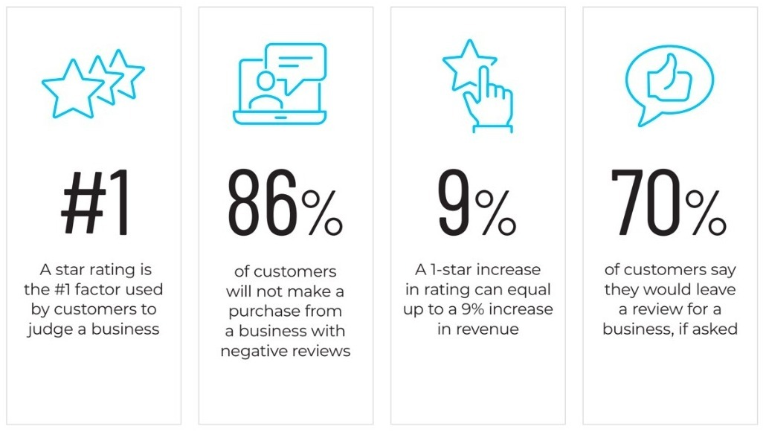
Importance of Online Reviews in Digital World
As of January 2020
Online Reviews Based Trust Ratio continues to rise day by day in more countries and cities.

Slide 6
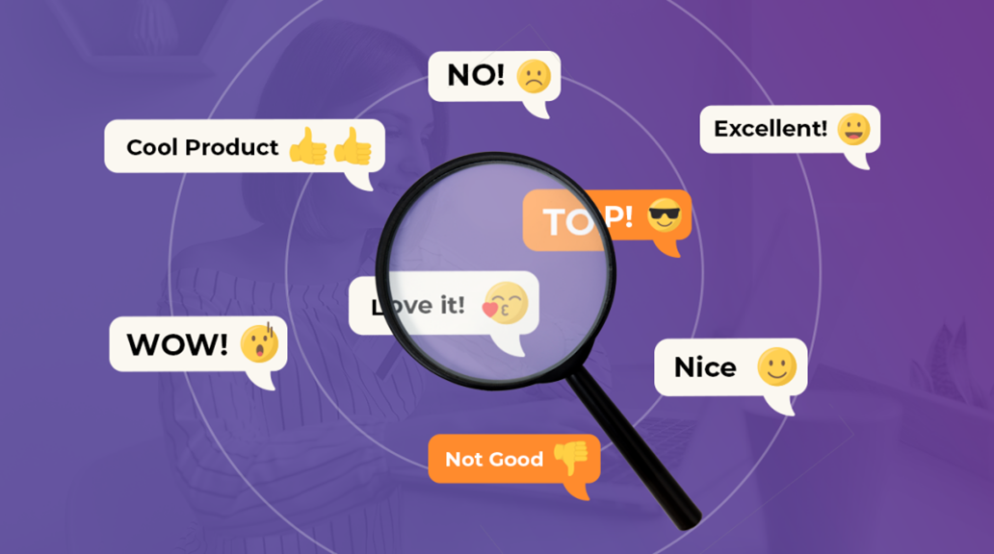
System Objectives
Goal to achieve
Our idea is to come up with a generic recommendation system that would be able to recommend different businesses on the basis of reviews. Moreover, we will make this process dynamic

Slide 7
1
Recommend on the basis of feedback from group of people
2
Incorporate Multiple Businesses in single platform
System Objectives
3
System’s intelligent ratings
4
Take updated user feedback into account
5
Use Flexible State of the Art Model.

Slide 8
System’s Flow
Login
Add Location
Get Recommendations
User will login into system by providing correct credentials.
User will add location of which recommendation need.
Location pass to the system and data is retrieve from database, if not available will fetch from Yelp MAP API.
Show Recommendations
On the basis of filters like best system ratings, price etc. data will be shown to user accordingly.
Reviews & Ratings
User will give ratings and reviews against the places which is recommended by system and those will store in database for next step.
Dynamic Flow
Update the ratings on the basis of newly generated feedback.

Slide 9
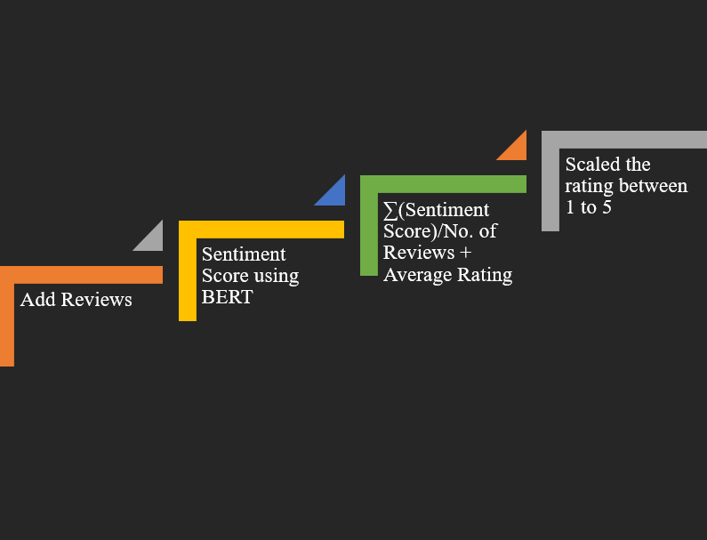
How we Generate Ratings?

Slide 10
Pre-Decided Locations
Projects Scope
Initial Review
Language Barrier
Appointment and Bookings

Slide 11






Tools and Technologies

Slide 12
Demo

Slide 13
Reservations
We can provide reservations of different modules in future, which will take a lot of burden off from user side.
Future Work
Model Retraining
We will going to clean live comments of users and try to integrate reinforcement learning algorithm, that will help to make our system dynamic.
Local Places
In future we can integrate Google’s API (Which will cost rather mode) to get reviews of local places so that we can give Pakistan base recommendations.

Slide 14

Do you have
any questions?
Ask to us! We hope you learned something new.

